Slide 1

Predicting Legends
Dan Jahnsen, Kieran McAleer, Aki Jain, Kyle Terramoccia, Lily Carbonara

Slide 2
Objective: Predict Legendary Status of Pokemon
Legendary Pokémon are group of Pokémon considered to be very rare and powerful. In this project, we used machine learning tools to predict whether a Pokémon is legendary.

Slide 3
Dataset
Includes:
Pokemon Generation 1 – Generation 6
Primary Type
Secondary Type
Total Stat Score
Individual Stats (Attack, Defense, HP, Speed, Sp. Attack, Sp. Def)
Generation
Legendary Status

Slide 4
In reviewing data, we noticed… (1) Wide ranges of stat values (2) Nominal % of Pokemon are actually legendary

Slide 5
Data Pre-Processing
Normalizing
Encoding
- Label encoded 18 types of Pokemon
Splitting Sample
- Random sample of total dataset did not ensure representative sample
- So few legendary pokemon biased our model when using usual train/test/split process
Balancing Training Data
- Stat values had wide range
- Normalized to account for outliers
- One-hot encode each Pokemon’s type
- Divide data by legendary v. non-legendary, then re-did train/test/split
- Needed to balance data to increase legendary pokemon when training model
- SMOTE

Slide 6
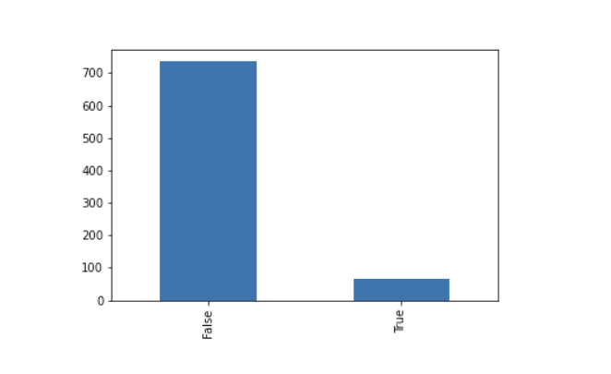
Balancing Training Data

Slide 7
Models
Linear Regression
Failure
Random Forest
Success!
Score: .04
Missed several pre-processing steps
Did not match objective or data shape
Training Score: ~99%
Testing Score: ~93%
Aligned with goal of classifying Legendary v Non-Legendary
Enabled us to feed in multiple variables

Slide 8

QUESTIONS?

